Slide 1




When the Stars Align:
Why 2020 is the Year for Charitable Gifts
John Kraemer, CSPG | Partner
Steve Chidester | Partner
Conejo Valley Estate Planning Council
August 25th, 2020

Slide 2
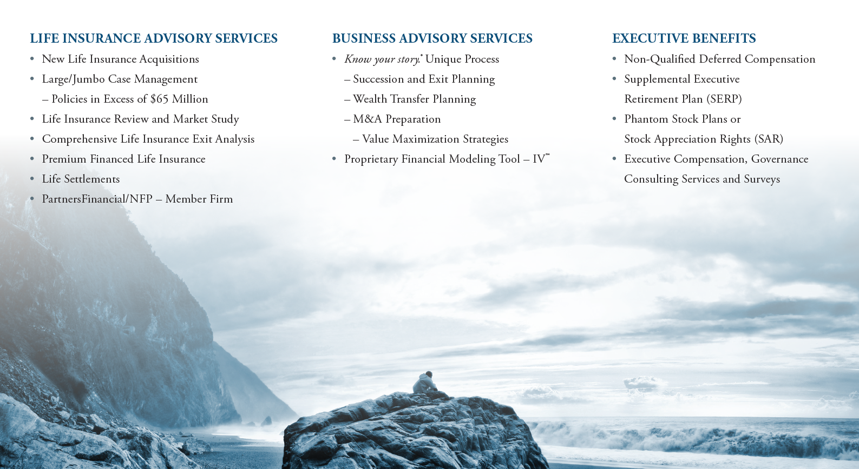
WealthPoint Overview

Slide 3
Withers Overview
Withers combines traditional private client legal advice with sophisticated business and investment planning in one integrated legal practice to service global high-net-worth clients and their businesses.
    Withers is the largest international law firm focused on the individual needs of successful people, their families and their businesses
    We are a full service firm championing our clients’ interests locally and globally from our 17 offices in the US, Europe and Asia-Pacific
    Our presence in California includes offices in Los Angeles, San Francisco, Rancho Santa Fe, and San Diego
    Our California offices cover a wide range of practices including investment tax and trust planning, estate planning, philanthropy and charitable giving, family offices, art and cultural assets, corporate, business tax, real estate, intellectual property, litigation, and dispute resolution
    We combine local knowledge and international skill to address the global dimensions of our clients’ requests
    We work closely with high net worth individuals including industry leaders, senior executives, trustees and fiduciaries, as well and families around the world. We also represent governments, financial institutions, public companies, international brands, and charitable organizations
1896
1100
160+
50+
17
Firm founded
People
Partners
Languages
Offices

Slide 4

Charitable Planning in 2020 - Overview
Combining the gifting, estate planning and charitable giving landscapes
Recent legislation enhances the impact of combining estate and charitable strategies
Identify why 2020 is the ideal year for philanthropy while also completing legacy family plans

Slide 5
2020 is the “Perfect Storm” for Gifting
2020 is an opportune time for high net worth individuals to transfer their wealth
  Business values depressed due to global economic environment
  Increased volatility results in larger discounts on assets, business valuations, minority interests
  Applicable federal rates (AFRs) and §7520 rate are at all-time lows
  Significant gift-tax exclusion remains for many taxpayers
  Taxes of all types are anticipated to increase in near future
Results in significant estate planning opportunities for gifts, intra-family loans, GRATs, installment sales, charitable lead trusts, etc.
These conditions are predicted to endure for a time . . . But no time like 2020 to plan!
Helpful tool on the next page: tinyurl.com/LowVLowR

Slide 6
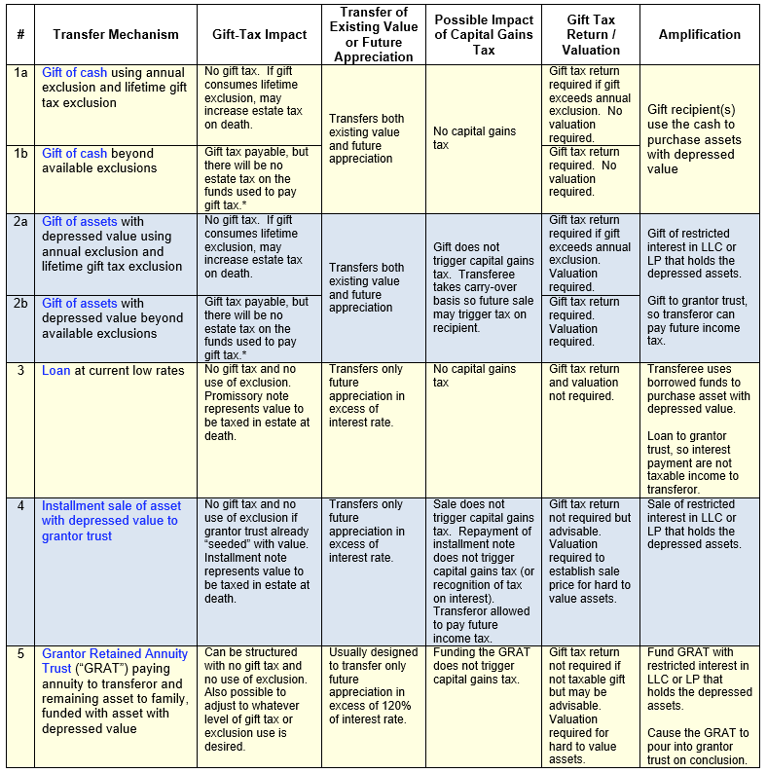

Slide 7
Legislation &
Tax Code Changes

Slide 8
Secure Act & Cares Acts
SECURE Act (Dec. 2019)
  — The “stretch” IRA for children is no longer allowed
  * Result: Beneficiaries receive funds and pay income tax sooner than planned
  — Incentive for using QCDs, testamentary giving and naming a CRT as beneficiary of IRA
  — For philanthropic individuals, charity is the most efficient IRA beneficiary
CARES Act (March 2020)
  In 2020, you may deduct 100% of AGI for cash gifts to operating and public charities like LJI
  Qualifying cash gifts by partnerships and S-Corps also eligible
  C-Corps, taxable income limit for gifts from corporations is increased from 10% to 25%
  Private non-operating foundations, supporting organizations, and donor-advised funds do not qualify.

Slide 9
Planning Opportunities

Slide 10
1. CARES Act - Cash Gifts to Operating Charities
CARES Act
  100% of AGI cash gifts lead to new planning opportunities
  Can accelerate ability to transfer wealth to family with minimal tax while gifting to charity
Cash Gifts vs. Appreciated Assets
- Donors often make gifts of appreciated assets. Deduction use limited to 30% of AGI.
- In 2020, a cash gift at 100% of AGI may be more advantageous than a gift of appreciated assets
- Note: Check state law for AGI limits and analyze the numbers for benefits
Net Operating Loss Carrybacks (NOL) – Estimated $135B in tax refunds will be made to HNW Business Owners. 82% of benefits to those with $1M/year AGI. $1.6M average refund (source CJT)
NOL carrybacks allowed up to five years for taxable years 2018-2020. Losses offset 100% of income
  Creates significant immediate tax refunds… refunds can then be gifted to family, invested, or gifted to charity…generating more tax benefits
Creating large tax deductions and NOL tax refunds = incentives for gifting in 2020 – a year of great need
Ideal time to combine NOL and cash gifting with Roth IRA conversion and estate planning

Slide 11

2. Charitable Lead Annuity Trusts - No time like Now
Charitable Lead Annuity Trust
  Trust makes an annual payment per a fixed schedule to charity
    After trust terminates, remaining assets are distributed to non-charitable beneficiaries or a trust for their benefit
  The tax angle:
    The present value of the remainder interest is a taxable gift
    The present value of the income stream to charity is available as a gift-tax charitable deduction, as well as having potential income tax savings benefits
  - Investment hurdle rate for CLAT only 0.4% §7520 rate (rate is good Aug-Oct)
Why now?
  Depressed asset values reduce the gift tax cost of transfer to non-charitable beneficiaries
  Low interest rates increase the present value of the income stream, which increases the gift tax deduction
  Appreciation in excess of assumed growth rate transfers free of gift tax to heirs
Note: the low §7520 rate will also benefit clients using a GRAT to transfer wealth

Slide 12
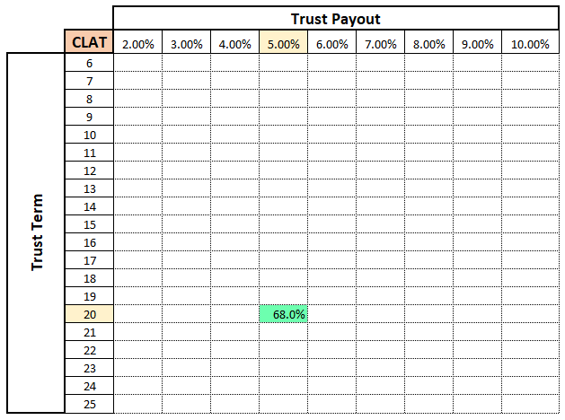
Illustration: Charitable lead Trust
§7520 Rate: 4.0%
Transfer: $20,000,000
Gift-tax deduction: 68%
Taxable Gift: $6,409,600
Gift Tax: $2,563,840

Slide 13
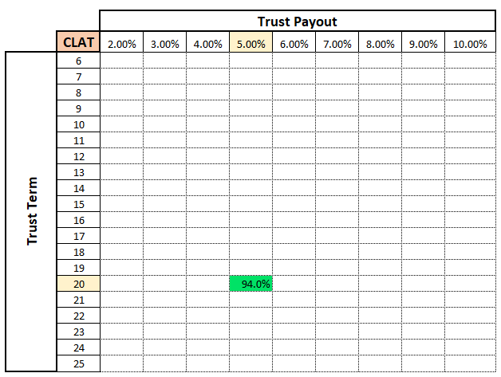
Illustration: Charitable lead Trust
§7520 Rate: 0.6%
Transfer: $20,000,000
Gift-tax deduction: 94%
Taxable Gift: $1,206,400
Gift Tax: $482,560

Slide 14
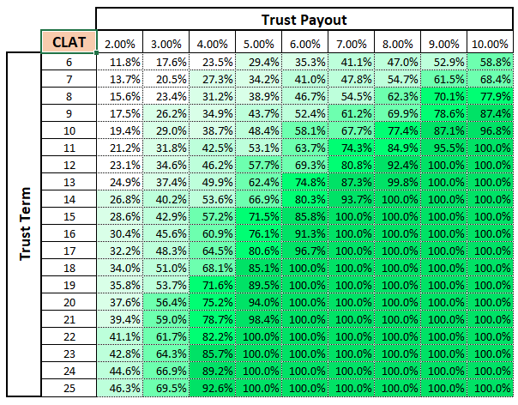
Illustration: Charitable lead Trust
§7520 Rate: 0.6%

Slide 15
3. Turn IRA into IRA Charitable Remainder Trust
With the SECURE Act, gift of an IRA to a CRT provides income to heirs over a longer period
The CRT makes annual payments for life or a term of years to the current beneficiary(s)
  At the end of the term (or life), the remaining assets will be distributed to the charity(s)
  If annual payments are specified, then trust is a Charitable Remainder Annuity Trust
  If fixed percentage is specified, then trust is a Charitable Remainder Unitrust
  If there is a goal to defer income during working years, then a NIMCRUT can be used.
Ability to defer gain allows increased income, growth, and diversification
  IRA- CRT is exempt from tax on its investment income; distributions primarily ordinary income
  Ideal vehicle to benefit heirs with cash flow… and provide remainder gift to charity
  The IRA - CRT has many benefits:
Provides annual cash flow to the current beneficiary. Present Value of the cash flow is a gift to heirs
Donor reduces value of gift to heirs by present value of remainder interest going to charity
CRT must be established and designated as IRA beneficiary during lifetime of participant
-14-

Slide 16




IRA CRT: How It Works (Example)
$8.2M IRA
Invested at 6%
Charitable Remainder Trust
Tom
Ashley
5% of FMV Paid Annually to heirs
After 20 years – $10M Distribution to Schools
IRA transferred to CRT at death earns 6%
Heirs receive 5% payout for 20 years
Heirs receive $9.3 million in taxable distributions
Heirs can choose to gift some of the income, or terminate the trust and transfer corpus to charity
Remainder passes to charity – grown to $10 mil.
$5,000,000 Ashley & Tom’s Post-Grad
$2,500,000 Tom’s Undergrad
$2,500,000 Ashley’s Undergrad
-15-

Slide 17
4. Roth IRA conversions Combined with Charitable Gifts
SECURE and CARES Acts create “perfect storm” to consider a Roth IRA conversion
Converting from a traditional IRA to a Roth IRA results in income tax impacts
  Ordinary income tax will be owed on the converted portion of the traditional IRA
  Roth IRA will no longer be subject to income tax…for as long as it continues
    No longer an IRD asset
  Roth IRA subject to gift and estate tax…but now a very income tax-efficient asset for heirs
Combining a charitable gift with Roth IRA conversion mitigates current and future income taxes
  Qualifying cash gift in 2020 results in a tax deduction at 100% of AGI
    Gifts can be structured to offset the tax owed from the IRA conversion
Roth Conversions are ideal when paired with large cash gift (subject to 100% of AGI deduction) in 2020 and/or formation of CLT for wealth transfer in 2020
Ideal way to benefit charity and create tax-free income bucket for yourself of family

Slide 18
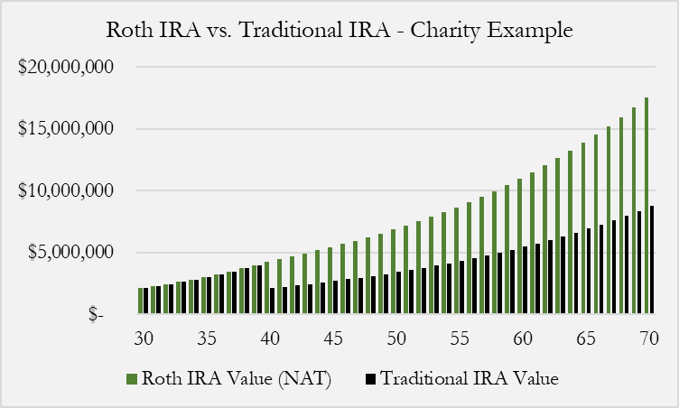
Case Study: $2 Million ROTH IRA Conversion
Fact Pattern:
  Client wants grandson, age 30, to inherit $2M IRA for his retirement. Also plans on leaving $2 million to charity in will
  SECURE Act ended the “Stretch IRA” so funds must be distributed within 10 years
  Assuming 7.2% growth, the IRA will be worth $4M (pre-tax) at the end of 10 years - $2M net after-tax distribution
  Roth Conversion Solution:
  Roth Conversion made in 2020 and the $2 million cash donation to offset the taxes owed from Roth conversion
  At the end of same 10 years, the Roth IRA would be worth $4M with no tax owed vs. $2M afte-tax with traditional IRA
At the end of same 10 years, Roth IRA would be worth $4M with no tax owed vs $2M after-tax with a traditional IRA
If grandson inherited at age 30, and Roth vs. traditional comparison was made at age 40…
  Project forward 30 years until his retirement – Assume 4.8% growth after tax.
  Value at age 70 – Roth sourced - ≈$16M vs. ≈$8M with Traditional IRA sourced funds
All created from a $2M cash gift in 2020 vs at death
Same estate tax on transfer at death between the Roth IRA and Traditional IRA

Slide 19
5. “The Compound Gift” – the Gift that Keeps on Giving
“The Compound Gift” optimizes tax savings from an initial gift to charity to fund ongoing, future charitable contributions … either outright or as Planned Gifts
  First gift of cash or appreciated asset results in an income tax deduction and tax savings
  Donor pledges tax savings. Added gifts compound tax savings. Creating more gifts….
Ideal for individuals who have non-income assets, IRD assets, or assets they no longer need
  Ex: Concentrated stock position, non-income producing real estate, bonds (if donor can forego income), insurance policies in the estate, annuities, art, personal property
2020 is a unique year for comparing the benefit of traditional gift of appreciated assets vs. sale of assets with gift of cash instead. Both are “Good”. Facts and analysis determine which is “Better”
As tax brackets and AGI increase, value of deduction carryforward increases
  Higher tax bracket = Greater tax savings = Increased compound giving

Slide 20


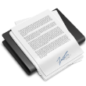

Compound Gift – Leveraged Charitable Solution
Initial Gift
Charitable
Current Gift & Future Tax Savings
Trust
Cash Gift, Endowment, or life insurance funded from tax savings. Future tax savings pledged
  Donor pledges tax savings from current gift…as well as compounding tax savings.
  At the time of death, the charity receives the endowment or full death benefit
  No out of pocket cost to policyholder or charity. Gifted tax savings create endowment
  Policy designed with premium flexibility if tax law or AGI changes … or donors’ health.
It’s donor’s choice and charity’s stated preference which of the 3 approaches are taken (or combo):
1) Cash gifts are used for current programs. No endowment. Ends with last gift
2) Endowment built with tax savings funds with 5% annual distributions
3) Life policy approach creates no current gift, but largest endowment for posterity

Slide 21
2020 The Compound Gift, Post-CARES Act Cash Case Study

Slide 22
Cash Gift vs. Endowment
Fact Pattern
Donors have made a large cash gift to charity
Donors are willing to use the subsequent tax savings from the previous year’s gift in each subsequent year (a “compound gift”)
The charity agrees to use the donations to create either an endowment or purchase a joint life insurance policy. If endowed, value is gifts + growth – 5% annual distributions
  If endowment is used …. Total benefit $5,131,092 during lifetime
  If insurance is used …Death benefit: $9,344,477. Endowment commences
  ROI on insurance:
    Year 10: 16.46%
    Year 15: 10.29%
    Year 20: 7.48%
    Year 25: 5.87%
Endowed Value of “Life Gift”
Accumulated Endowment + Distributions
Endowed Value of Cash Gift at 5%
-21-

Slide 23
2020 Compound Gift -Life Insurance Specifics

Slide 24



6. Qualified Charitable Distributions from Ira
Qualified Charitable Distributions (QCD) are direct gifts to qualified charities from an IRA
  Donation is excluded from Adjusted Gross Income (AGI)
  Satisfies Required Minimum Distribution (RMD) rules
Limitations to QCD:
  Must be 70^{1/2} before making a QCD
  Cannot exceed $100,000 per person per year. If each spouse has an IRA = $200,000 year
  Distributions must be made from the IRA directly to the public charity
    No taxable income & no itemized deduction
  QCD can NOT be made to private foundations or donor advised funds
  Charity must provide a contribution acknowledgment to the donor
QCD Gift
Bypass Donor
IRA
Charity

Slide 25
Case Study: How To Build an endowment with QCD’s
Fact Pattern
Couple aged 70 ½, each with a large IRA. Wish to use a portion of IRAs to endow charitable gifts. QCD approach optimizes their gift & estate planning goals for family and charity
Each use $100,000 QCDs from own IRA for annual gifts to charity of choice
Donors can choose current projects or build endowment
Over 25 years, $5 million is gifted into endowment. At 5% endowment payout, $2.25 million is distributed for charitable projects
Note: the $5 million endowment is permanent. $250,000/year is received in perpetuity for programs
Accumulated Endowment + Distributions
Endowed Value of Cash Gift at 5%
-24-

Slide 26





Shift in Planning
Wealth Transfer has never been easier
  Ultra-high net worth are bumping into the question: “How much is too much for my kids?”
  Philanthropy is more important than ever
    Wealth at younger ages
    Gifting during lifetime
Repositioning balance sheet to achieve desired results
We have seen a shift in how high net-worth individuals are utilizing their assets in 2020
Non-Qualified Assets
Qualified/IRD Assets
Step-up in basis
IRD Assets
Business assets
Investments
Real estate
Roth IRA
Life Insurance
Retirement plans
Annuities
Life Insurance
Cash
Heirs
Philanthropy

Slide 27
Summary: Planning in 2020 – Cash, Tax, Techniques
Charitable planning techniques to consider
  Cash gifts to operating charities with 100% AGI deduction
  Charitable Lead Trusts – never a better time to benefit family and charity
  Name IRA-Charitable Remainder Trust as beneficiary of your IRA
  Pair a 2020 Major Cash Gift or NOL carryback with a Roth Conversion
  Use the Compound Gift – the gift that keeps giving for many years
  Qualified Charitable Distributions – outright or endowed
  Utilize life insurance to leverage and endow future gifts.
Wealth transfer techniques to consider
  Grantor Trust
  Intrafamily loan
  Installment sale with a note
  Dynasty Trust
  Charitable Lead Trust
  Use life insurance to cover tax liability. More for family = more available for charitable gifts

Slide 28


Slide 29
WealthPoint Disclosures

Slide 30
