Slide 1
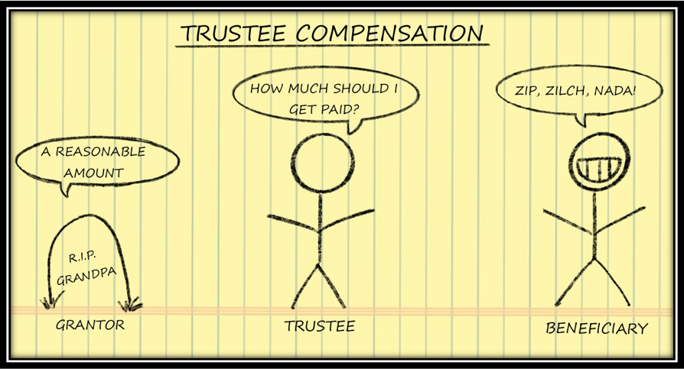
How much should a trustee be paid? An analysis of the California Rules of Court 7.776
Josh@anodosadvisors.com (805) 899-1245

Slide 2
Approved for CPE/MCLE
Few trustees have a good answer to the question “How much Should I be paid”. Their professional advisors often disagree. Some say an hourly rate, some say a percent of the trust assets, and others say a flat retainer.
Should I charge an hourly rate and if so in what amount?
Should I charge a percent of the trust portfolio like the corporate trustee do?
If I delegate investment duties to a third party, should my fee go down?
Can I charge more if I serve a particularly “high demand” beneficiary?
How do I determine what the “custom in the community” is?
Is there any statutory guidance on what my fee should be?
---------------------------------------------------------------------------------------------------------------------
Anodos does not manage money or sell insurance. We help trustees develop and maintain a governance process that demonstrates they have fulfilled each of their duties of care.

Slide 3
Presentation Synopsis
Title: How much should a trustee be paid? An analysis of the California Rules of Court 7.776
Presentation Synopsis: “How much should a trustee be paid?” Few trustees or their professional advisors can provide a thoughtful or comprehensive response to this question. Not surprisingly, many beneficiaries and their professional advisors frequently object to whatever the answer may be. Disagreements about the trustee’s compensation are exacerbated during periods of heightened financial uncertainty. This presentation seeks to provide a road map for both trustees and beneficiaries, of how to answer the ubiquitous question, “How much should a trustee be paid?” .

Slide 4
Presentation Outline
In this seminar we will examine the eight factors that are to be considered when establishing a trustee’s compensation.
Duty to Pay Fair Fees: A trustee has a duty to incur only reasonable expenses. Section 16050 directs that, “In investing and managing trust assets, a trustee may only incur costs that are appropriate and reasonable in relation to the assets, overall investment strategy, purposes, and other circumstances of the trust." This duty applies to the payment of the trustee fees.
Instructions re Trustee Compensation in the Trust Document: “... if the trust instrument provides for the trustee’s compensation, the trustee is entitled to be compensated in accordance with the trust instrument.” CPC §15680.
Few trust documents define what a trustee’s fee should be paid other than to note their fee should be “reasonable.”
The court retains the authority to establish or approve the trustee's compensation. CPC §17200(c)(9).
The court retains the authority to prospectively modify the trustee’s direct fee, if principals of equity require doing so. CPC §16580(a).
When the trust is silent: Absent direction of the trust document, which is the case for most trusts, a trustee’s fee shall be “reasonable”. Section §15680 of the California Probate Code directs, “If the trust instrument does not specify the trustee's compensation, the trustee is entitled to reasonable compensation under the circumstances.”
Where the trust document is silent the trustee and the courts are the only party with the authority to set the fee.
It is not a violation of the trustee’s duty of loyalty when they set their own level of compensation. CPC §16004(c).

Slide 5
Presentation Outline (Cont.)
Determining “Reasonable Compensation”: Rule 7.776 of the California Rules of Court provides guidance on the factors that should be considered when establishing a trustee’s compensation. “In determining or approving compensation of a trustee, the court may consider, among other factors, the following:
The gross income of the trust estate;
The success or failure of the trustee's administration;
Any unusual skill, expertise, or experience brought to the trustee's work;
The fidelity or disloyalty shown by the trustee;
The amount of risk and responsibility assumed by the trustee;
The time spent in the performance of the trustee's duties;
The custom in the community where the court is located regarding compensation authorized by settlors, compensation allowed by the court, or charges of corporate trustees for trusts of similar size and complexity; and
Whether the work performed was routine or required more than ordinary skill or judgment.
Document the Analysis: A prudent trustee will carefully document their facts and circumstances to each of the eight factors noted in 7.776 as they establish the fee that they determine is “reasonable”. The objective is to create the record that the trustee has carefully considered these facts before establishing what their fee will be.
Other Factors and Consideration:
Local Rules of court
Dual Compensation
Extraordinary Compensation
Valuation of Illiquid Assets
Notice re Change in Fees:
Annual Trustee Fee Declaration:

Slide 6
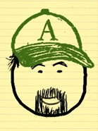
Josh Yager
Biographical Information
Experience
Josh Yager is a recognized expert on the management and oversight of trust assets. He lectures and writes extensively on the policies, procedures and practices for the prudent administration of trusts. He has been invited to speak to various Bar associations, CPA chapters, estate planning councils, Professional Fiduciary Association forums and AICPA national events. Josh has testified on the subject of prudent trustee governance practices before the Texas Pension Review Board, the Alaska Retirement Management Board and has provided expert testimony within the California courts. Josh has led governance consulting engagements for the boards of public pension funds responsible for assets in excess of $30b, foundation and endowment boards with assets in excess of $250m and for individual trustees with modestly funded trusts.
Professional Affiliations
CalBar, Estate Planning Section
Estate Planning Counsel, Santa Barbara
Professional Fiduciary Association of California (PFAC), Affiliate Member
Financial Planning Association (FPA)
Education History
Admitted to California State Bar
Certified Financial Planner (CFP®)
Chartered Financial Consultant (ChFC®)
Chartered Life Underwriter (CLU®)
Westmont College, Santa Barbara, CA (92)

Slide 7
References
Association | Chapter | Contact | Phone Number
CalCPA | Los Angeles | Mike Allmon | (310) 536-0200
EPC | Marin | Vince Crivello | (408)-260-3185
PFAC | Silicon Valley | Will Hoggan | (408) 712-9457
BDO | National Retreat | Jack Knuckles | (415)-490-3393
FPA | San Francisco | Tanya Shaw Steinhofer | (415)-516-3380

Slide 8
Reviews
“Josh is an engaging speaker with a firm command of the material.” – Michael Allmon (Los Angeles CalCPA)
“Josh’s presentation addressed an important subject for our members and was warmly received”. – Annabelle Wilson (Pasadena PFAC)
“The subject material was applicable to all of the professional disciplines in our Estate Planning Counsel chapter.” – Vince Crivello (Marin EPC)

